Slide 1
Project Management
An Intro to the Project Management Body of Knowledge
Presented by Jack Paradis, PMP
Jack@dingopress.com
2021

Slide 2
What’s this all about?
Review “traditional” project management tools, techniques and terms
Explore project manager role and scope of concerns
Introduction to Project Management Institute
Introduction to Project Management Body of Knowledge (PMBOK)
PMBOK relationship to other management methods/roles
Touch on some Kayak-OpenTable processes & assets important to a project manager

Slide 3
What’s this is not all about
A template or set of templates for managing projects
A comprehensive review of the PMBOK
A specific recommendation on what I think we should be doing
A deep dive into the art of project timeline management
A defence of project management & PMBOK vs something else
A magical enchantment to make you a good project manager at the end
An exciting and dynamic expose, unless you are excited by this kind of thing

Slide 4
Project Management Institute
A non-profit trade association founded in the 1970.
Over 2.9 million certified professionals and 500,000 members globally.
Maintains ANSI recognized standards for project management known as the “Project Management Body of Knowledge” or “PMBOK.”

Slide 5
What is a project?
Some Definitions
A specific, finite activity that produces an observable and measurable result under certain preset requirements.
A Project is a temporary, unique and progressive endeavor made to produce some kind of a result (a unique product, service, benefit, competitive advantage, etc.).
Usually includes a series of interrelated tasks that are planned for execution over a fixed period of time and within certain requirements and limitations such as cost, quality, performance, others.
So which are projects?
Leading a team toward delivering a stated “Objective” and “Key Results?”
How about resolving an incident?
Deploying a new incident manager system?
On boarding a user?
Delivering a “new user onboarding” procedure flow?
Project
Process
Project
Process
Project
Key Characteristics of a Project:
Temporary
Unique Deliverable(s)
Progressively Elaborated
Has requirements and limitations

Slide 6
What is a Project Manager?
Project Manager: A PMI certified project manager is primarily responsible for operating the inputs and outputs of the “integration management” process group.
Product Manager: A product manager is a professional role that is responsible for the development of products for an organization. Product managers own the business strategy behind a product, specify its functional requirements, and generally manage the launch of features.
Scrum Master: A named role on an Agile Scrum team identified as a “servant-leader” of the scrum team. Responsible for promoting and supporting Scrum. Scrum Masters do this by helping everyone understand Scrum theory, practices, rules, and values.
Product Owner: A named role on an Agile Scrum team responsible maximizing the value of the Product via management of the product backlog.

Slide 7
PMBOK -
Phases & Knowledge Areas

Slide 8
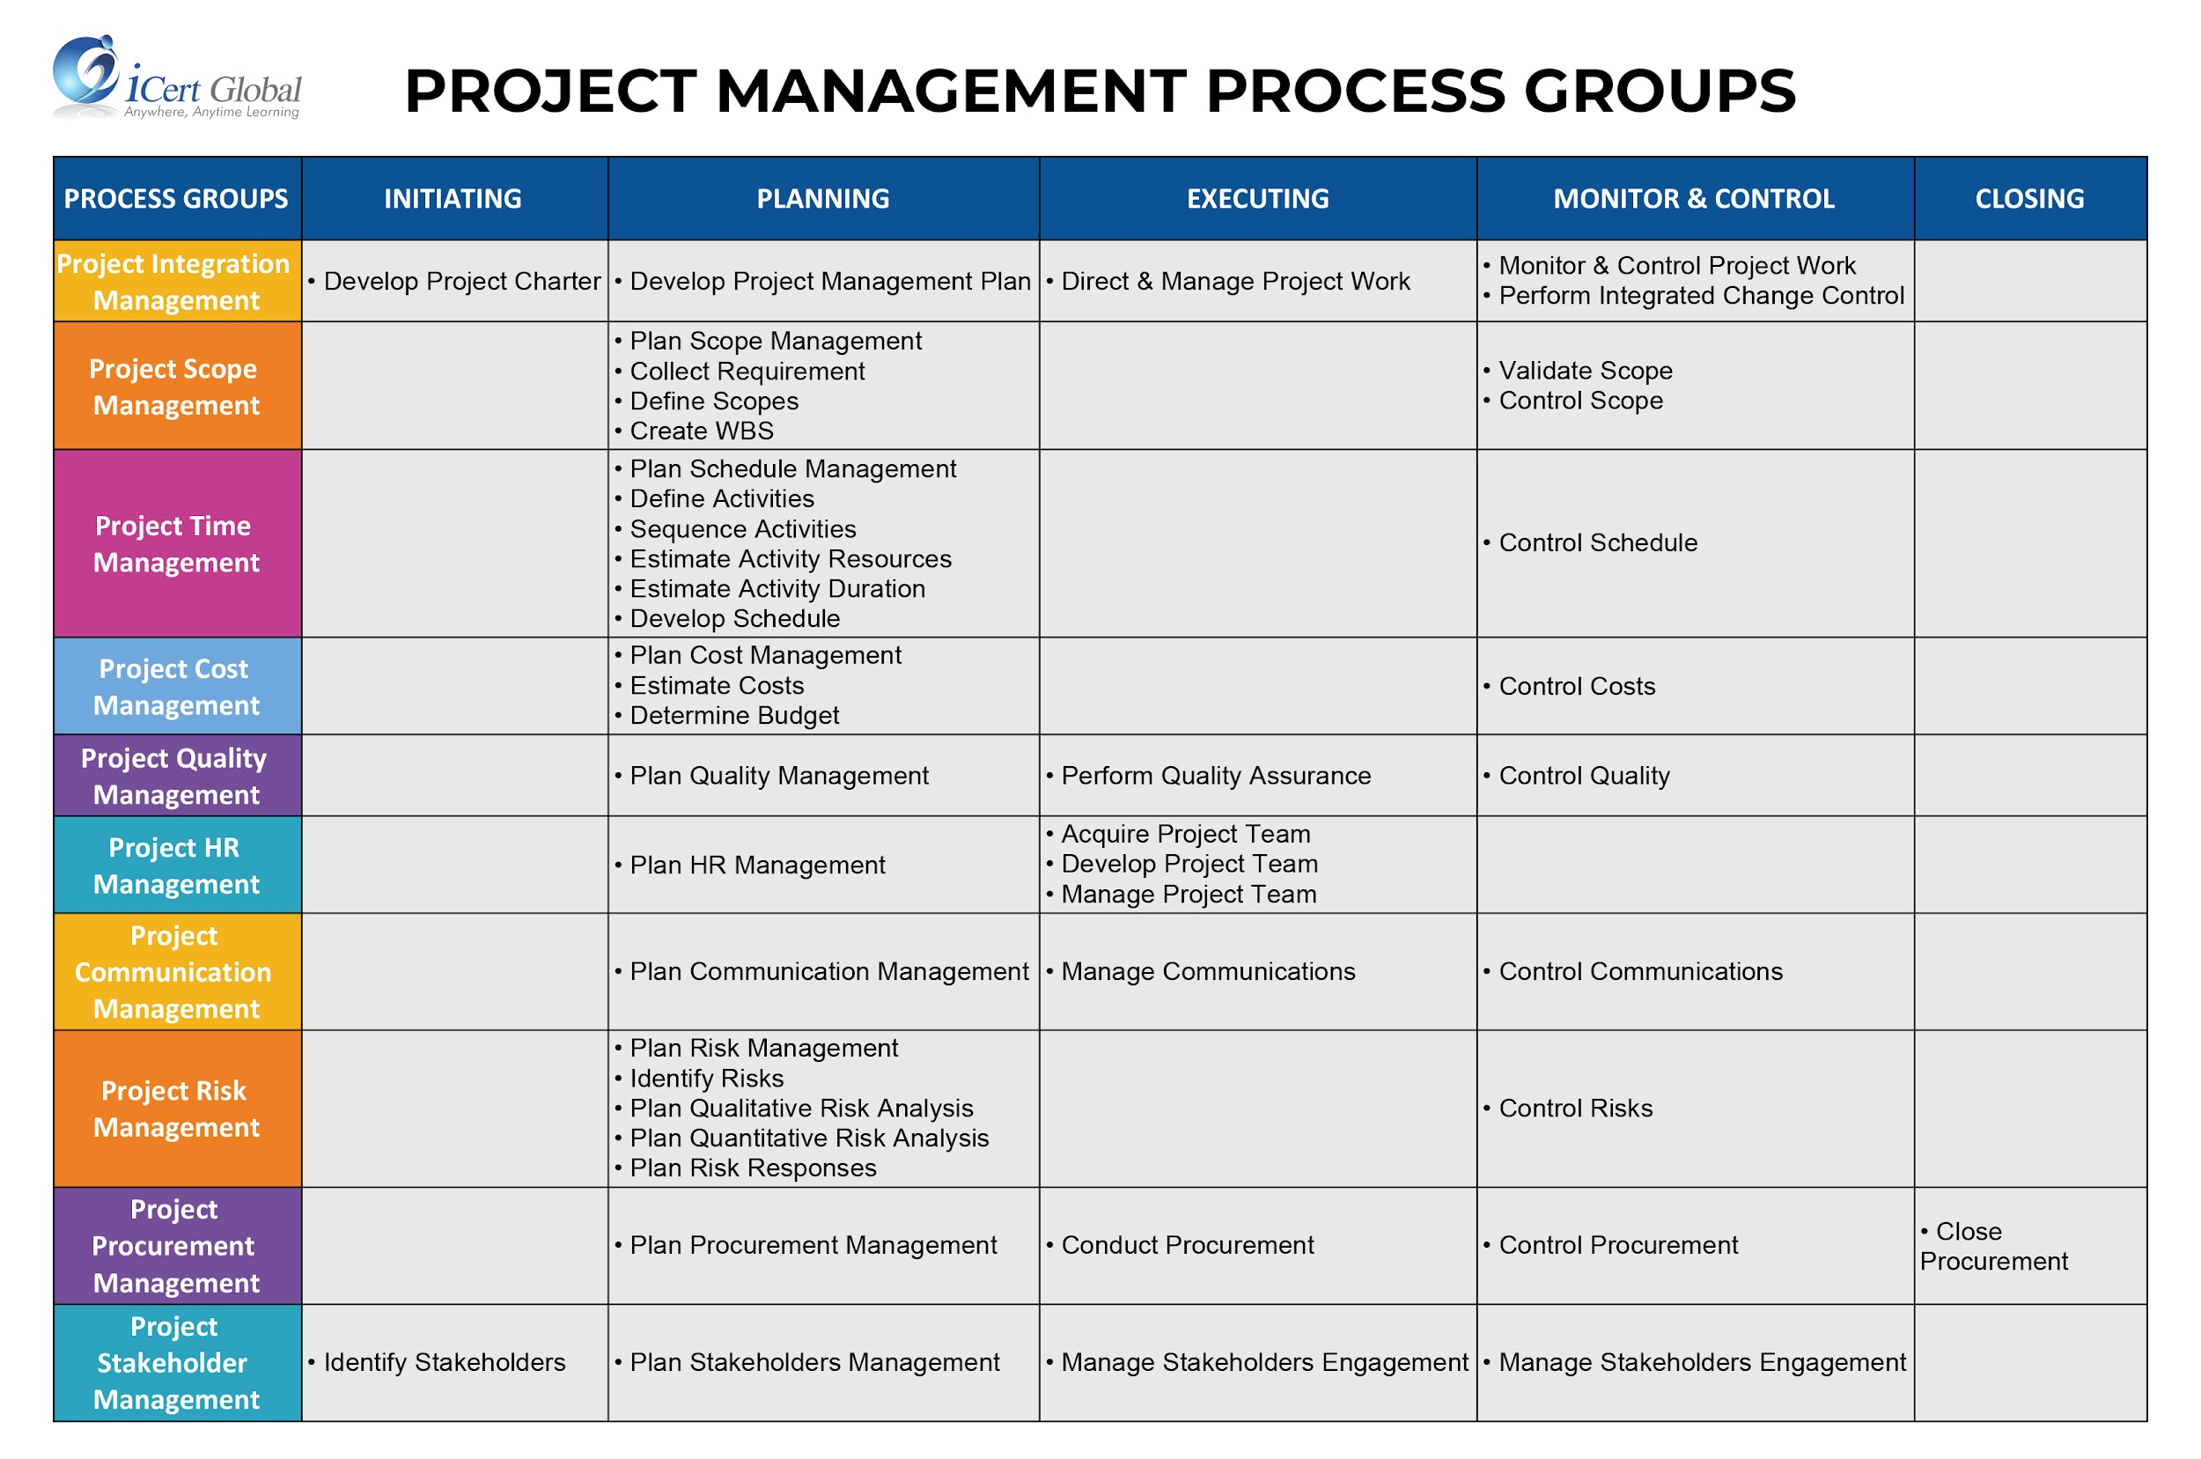
5 Phases, 10 knowledge areas, 49 processes

Slide 9
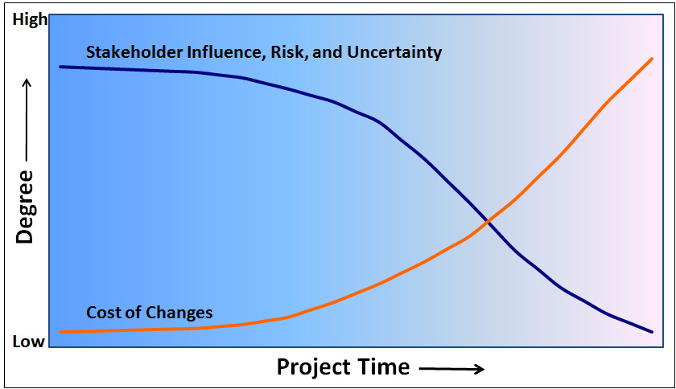
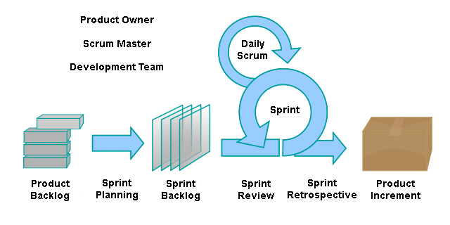
Project Phases & The Cone of Uncertainty
Time & Effort --->
Use A Framework..agile..sure!
Certainty = Estimate Variability
Comms, Status, QA &
Process Group Controls
|
|
A project ends
Management Plan
|
Charter
|
Progressive Elaboration --->
via Monitor & Control
Initiating
Planning
Executing
Closing

Slide 10
Integration Knowledge

Slide 11
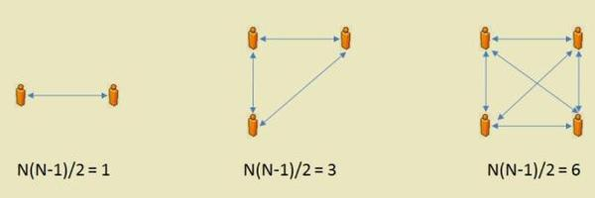
Project Managers Communicate
N * (N-1) / 2.
“I didn’t know.”
“Who the hell are you?”
“That’s not what I wanted.”
“No one understands what you are trying to do or why.”
“You can’t do that, cause we are doing this.”
“You don’t have budget approval for that.”
“Oh sorry, the thing you just bought does not do that.”
“It’s going to take much longer, you should have asked.”
“We can’t help because this is not a priority for us.”
Notes:
90% of the project manager’s effort revolves around this network map equation. Where N is the number of stakeholders, you can quickly see how communication points can spin out of control along with your project’s message.

Slide 12
PM via Integration Management
PMBOK and Project Management via the Integration Process Group
The first phase is “initiating”
The first process for integration is to develop the project charter
Stakeholder management also kicks off with stakeholder identification

Slide 13
Project Charter

Slide 14
Why Initiate with a Project Charter?
Establishes baseline for measuring progress, setting expectations and identifying success
“Authorizes” the project by identifying support from the sponsor*
Seeks consolidated, summary level, goal statements & constraints shared by all stakeholders
Assumed to be estimates with some +/- variance in schedule/scope to be elaborated.
However, explicit constraints, risks and scopes are included where known.
A clear vision must bound exploration.
*Sponsor - Usually the person who controls the funding for the project or represents the person(s) who does.
Further Investigation: https://www.pmi.org/learning/library/charter-selling-project-7473

Slide 15
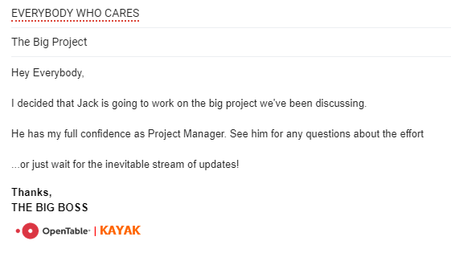
Here’s some tiny charters
“We’ve gone over the requirements and Bill here will run the awesome facial hair project.“

Slide 16
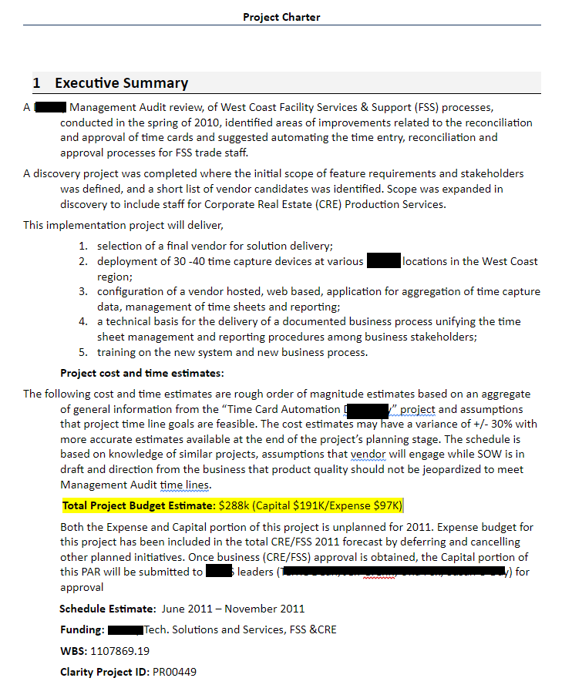
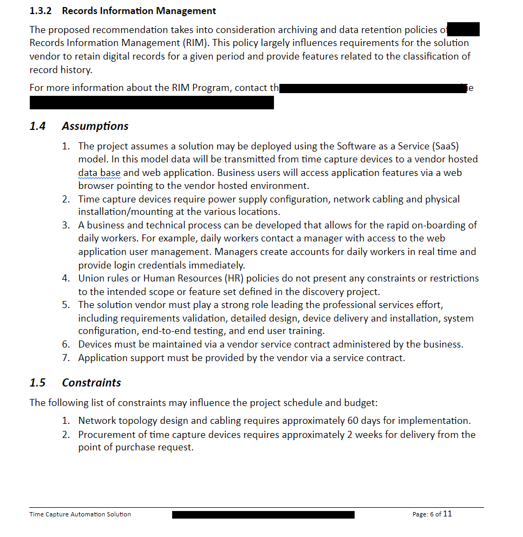
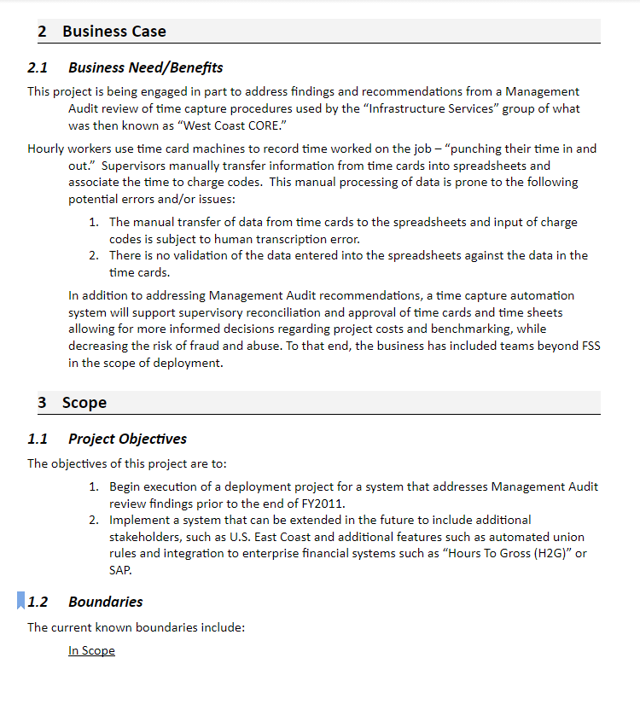
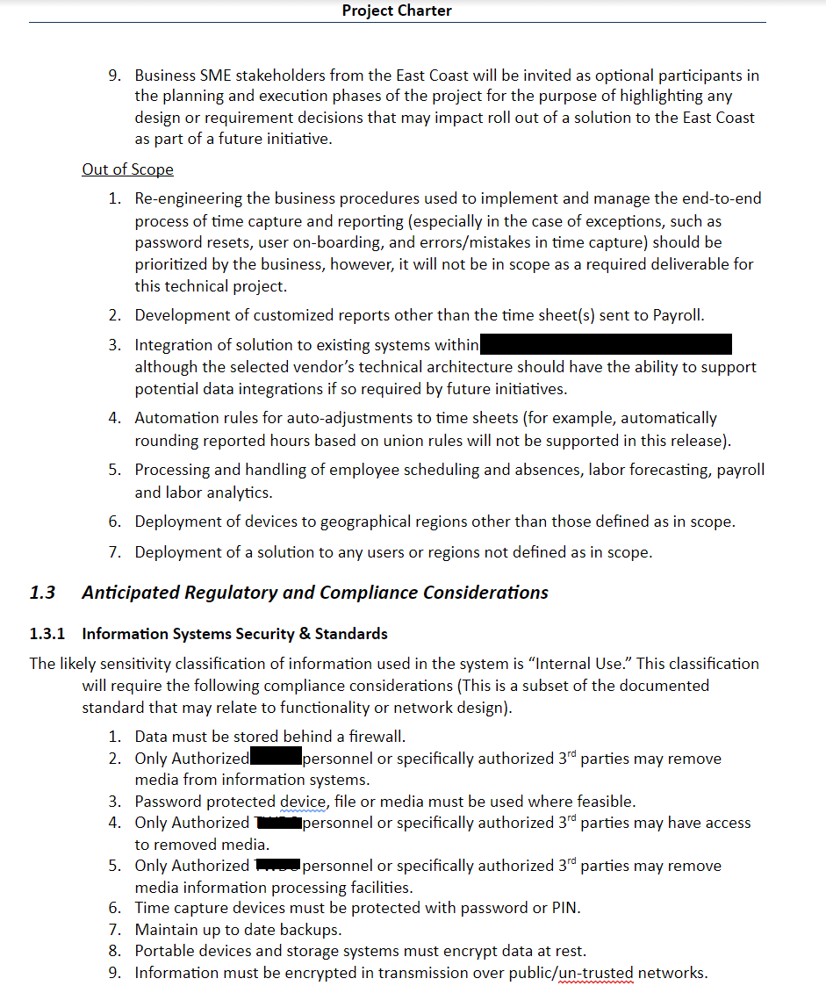
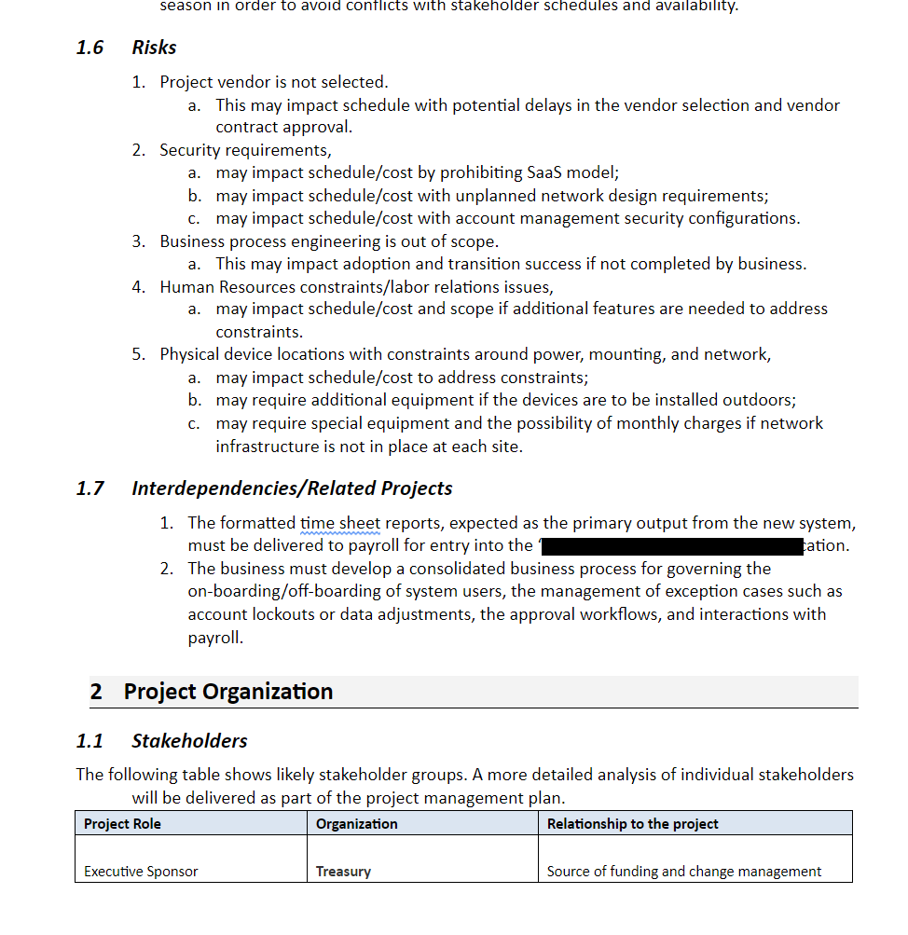
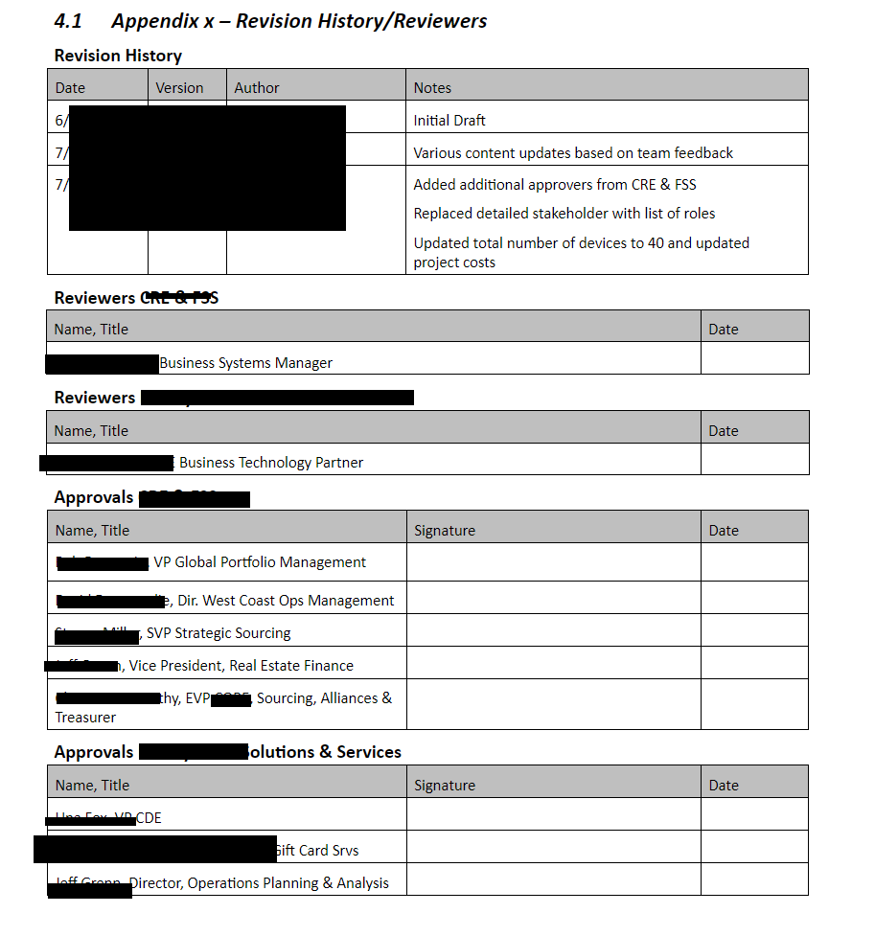
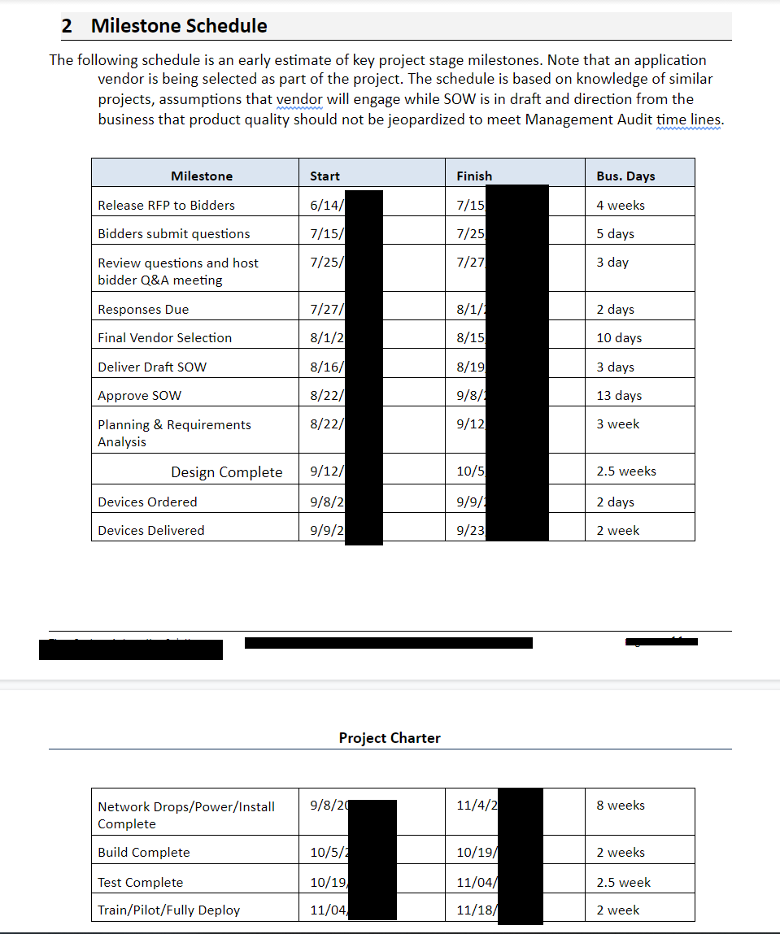
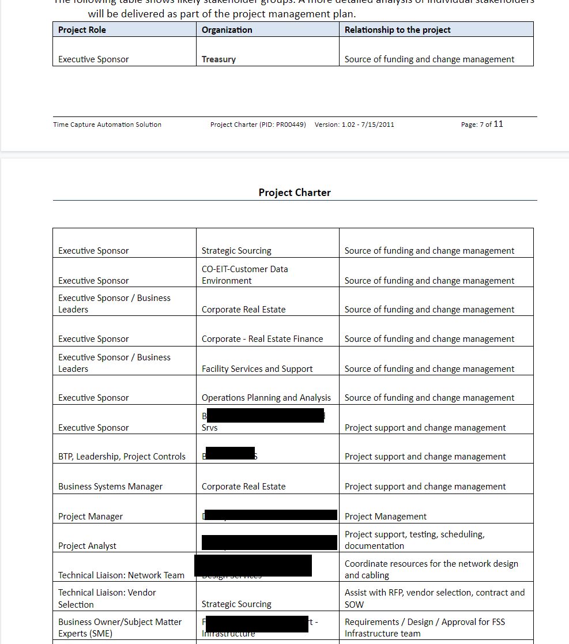
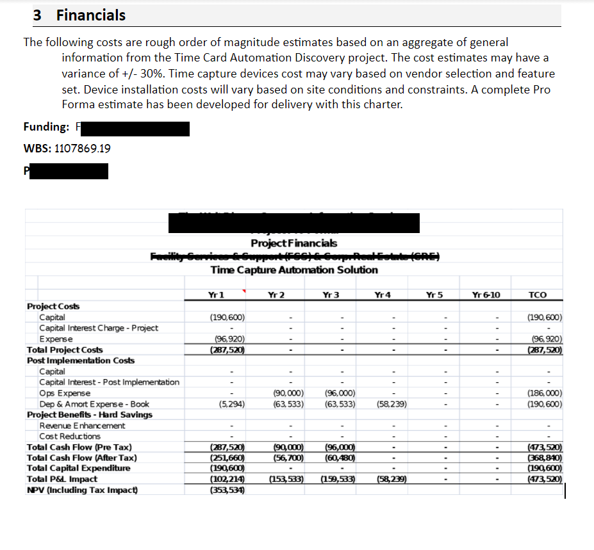
A bigger charter

Slide 17
Develop Project Charter PMBOK Process
Tools
“Expert Judgement”
Sponsor(s), key stakeholders, organization subject matter experts, you?
Consultants, support organizations...
Facilitation techniques
Brainstorming, interviewing, conflict resolution….
Input to Process
Project Statement of Work
Business Need and Product Scope Definition
Business Case
Agreements/Contract
Enterprise Environmental Factors
Organizational Process Assets
Outputs from Process
Project Purpose or Justification
Measurable Project Objectives
High-level Requirements
High-level Project Description
High-level Risks
Summary Milestone Schedule
Summary Budget

Slide 18
Inputs to develop a charter
Project SOW - Business Need - Scope Definition
Source information about what the “measurable result” should be
Sponsor or business teams initial ideas about what is needed
Leads to other background information and stakeholder discovery
Identifying stakeholders is a key process in initiation phase
Business Case
What is the justification for initiating the project?
Why is it valuable?
Helps to negotiate scope, prioritize against competition, and so on
Agreements/Contracts
Agreements could be existing informal understandings with internal/external parties
Contracts are formal, binding constraints
Both are key to identifying constraints and risks that will impact the project

Slide 19
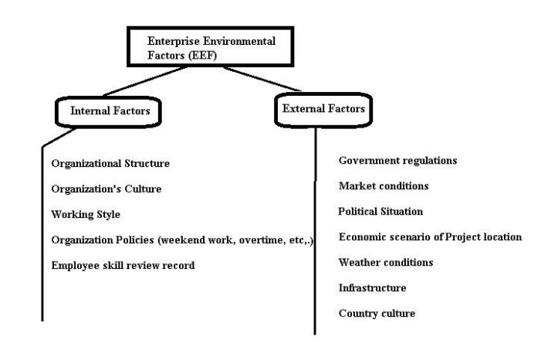
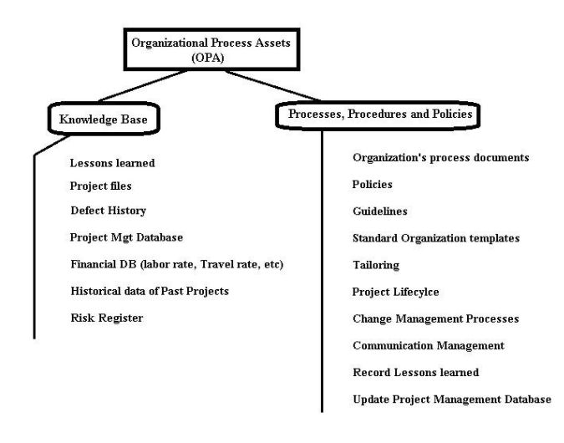
More charter inputs...
Enterprise Environment Factors (EEF)
Conditions, not under the immediate control of the team, that influence, constrain or direct the project.
Organizational Process Assets (OPA)
Anything the organization has acquired that you can use in project management.
Further Investigation: https://www.project-management-prepcast.com/pmp-exam/2-uncategorised/982-free-lesson-enterprise-environmental-factors

Slide 20
OPA vs EEF - What’s What?
Slack
Jira
G-Suite
Google Meet
TechTable
OT/Kayak Wikis
Inside Kayak
Apareol
Okta
Delivery Management Team
Quarterly Goals Process
Team Stand Ups
Team Slack Channels
Holidays
Code Freeze
HR, Finance, Legal Shared Service Teams
Booking Holdings Parent Org
Global Teams
Separate Calendars for Kayak/OT
Summer Hours
Separate end user support teams

Slide 21
Stakeholders

Slide 22
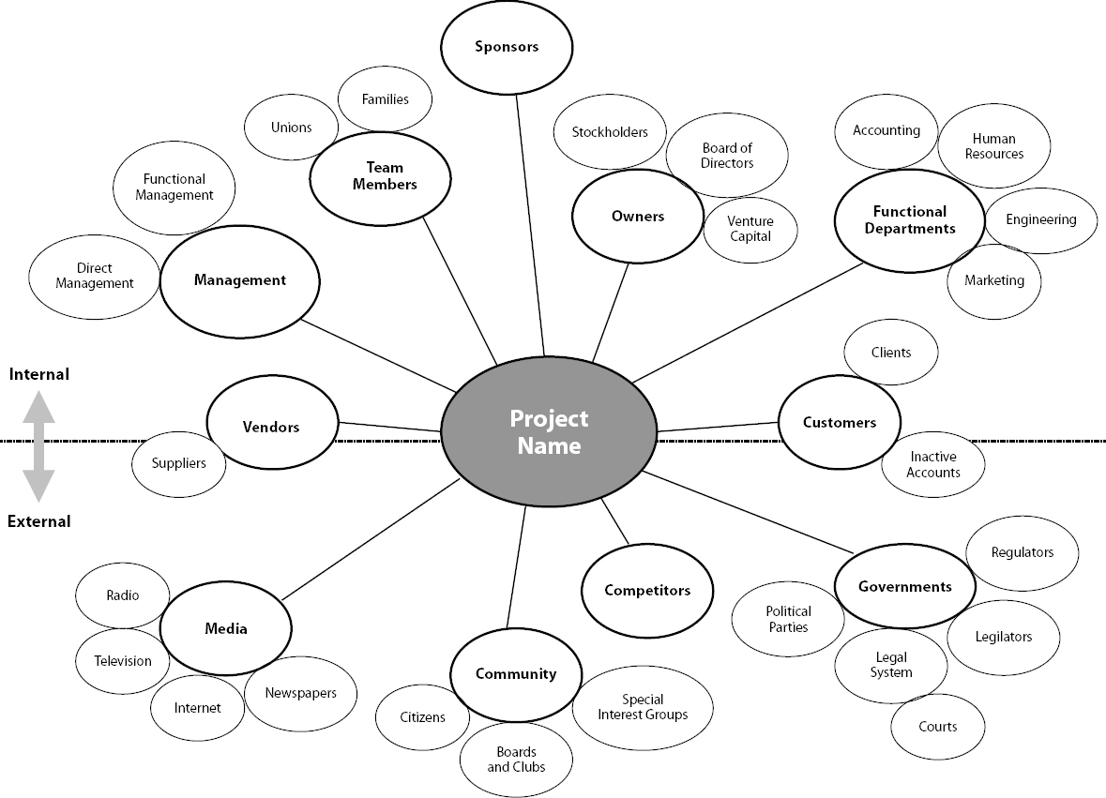
Who are the Stakeholders?
Individuals and organizations who are actively involved in the project, or whose interests may be positively or negatively affected as a result of project execution or successful project completion.

Slide 23
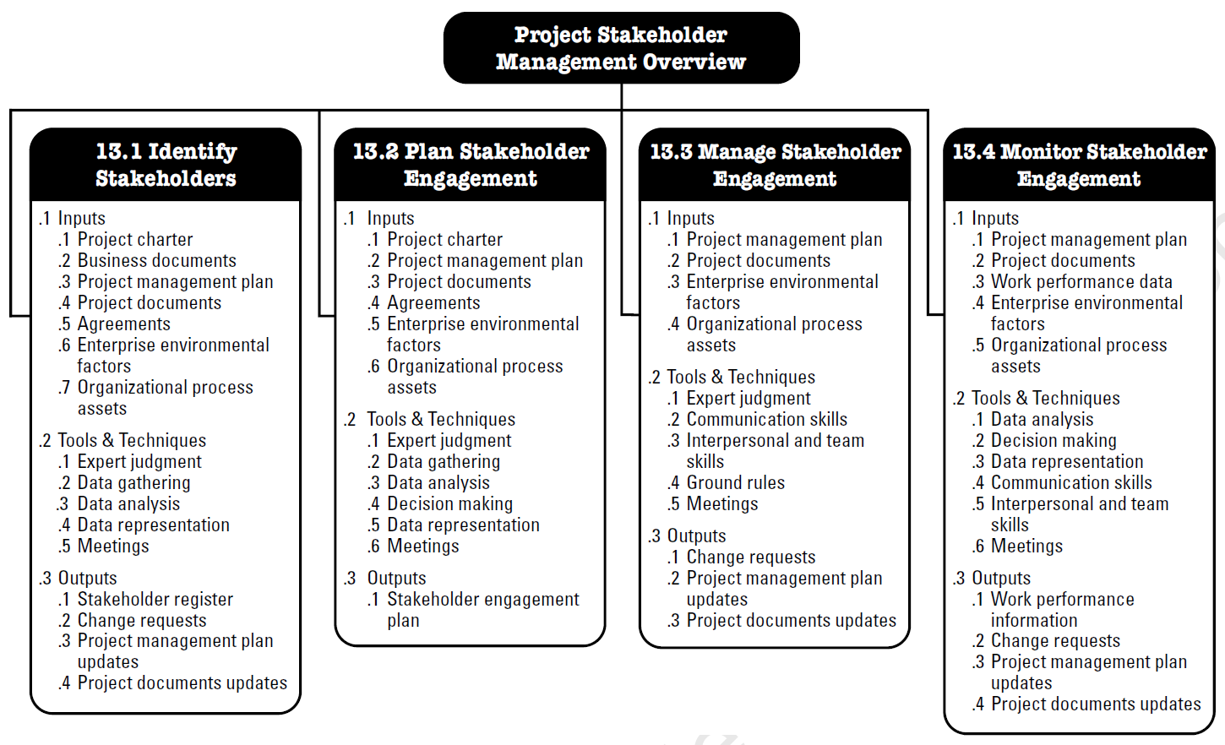
Stakeholder Management

Slide 24
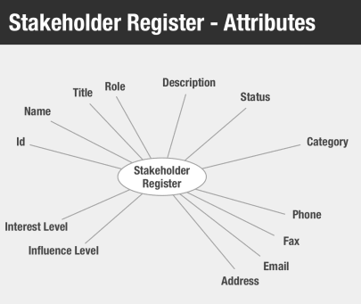
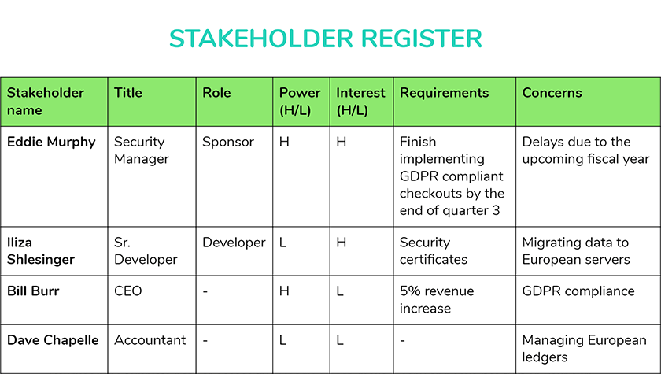
Identifying Stakeholder - Building Register
Initiation artifact for identifying scope of resources
May be useful for beginning to understand interest/influence
May contain roles that are required where actual resources are TBD
Gets brainstorming going on work streams and work breakdown structure
Critical to understanding the multiple dimensions of project scope
Stakeholder analysis begins a PM down the cone of uncertainty & can reveal critical constraints or opportunities

Slide 25
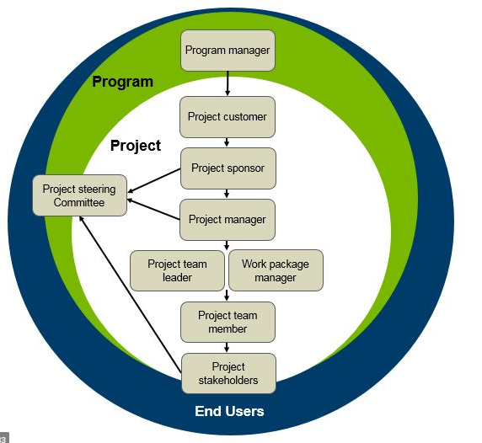
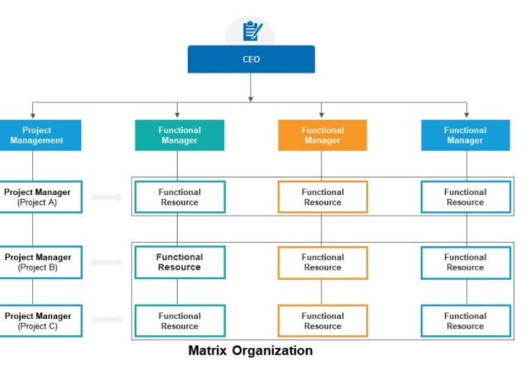
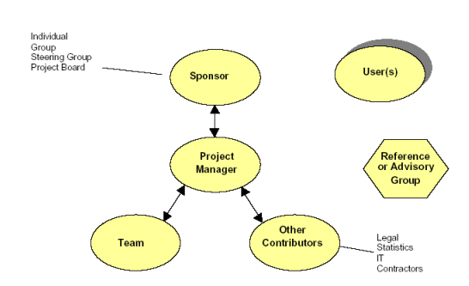
Chain of Command
A deliverable in the project management plan, but begins to take shape during initiation
Key to understanding escalation path
Understanding paths in a matrix organization is key to confirming project resources
Key to understanding “project teams” & visualizing interdependencies

Slide 26
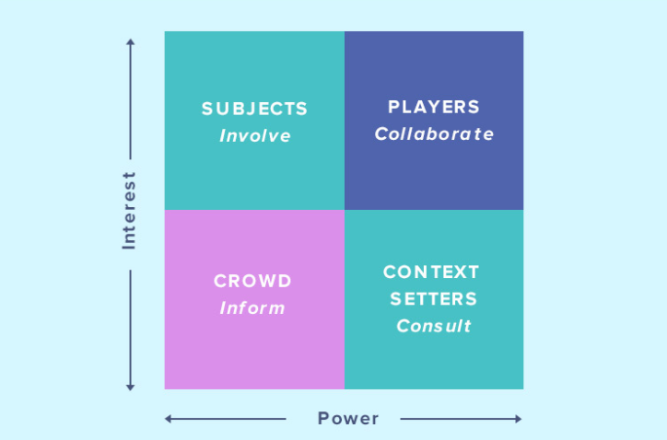
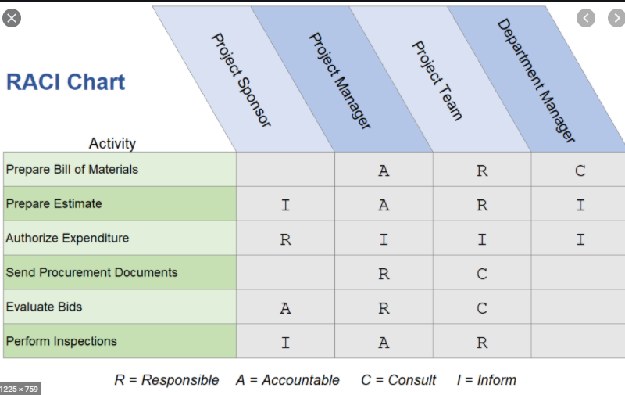
Manage Stakeholder Engagement
From initiation to planning - stakeholder engagement should be considered
The register suggests a basic assessment of interest - power - category
RACI (responsible, accountable, consulted and informed) is a more complex analysis of engagement
Many other tools and techniques are available for stakeholder analysis & engagement
Additional reading on stakeholders in agile scrum.

Slide 27
Example Charter - Paralos
Paralos Charter: https://wiki.runthedish.com/display/Platform3/Project+Paralos+Charter

Slide 28
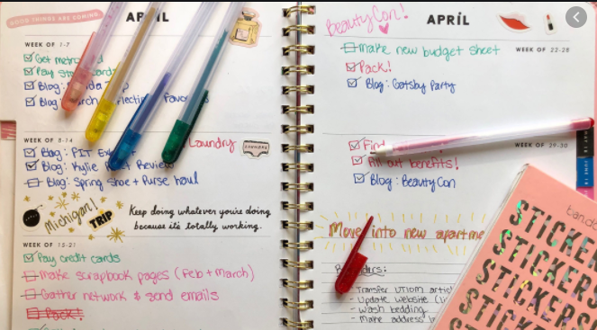
Planning

Slide 29
Integration Management - Planning
There are no edges in project management, but sometimes there are gates
The planning phase is often squeezed or thought to be done with the charter...not really
PMBOK defines planning as its own phase and expects “progressive elaboration” from the charter statements

Slide 30
Err...Project Management Plan?
The process of defining, preparing, and coordinating all plan components and consolidating them into an integrated project management plan.
Following are the key points about the Develop Project Management Plan process.
The project management plan is a comprehensive document that defines the basis of all project work and how the work will be performed. It defines how the project is executed, monitored and controlled, and closed.
The project management plan is tailored according to the needs of the project.
The project management plan can be revised as many times as needed before it is baselined. Once it is baselined, it can only be revised through formal change control (i.e. Perform Integrated Change Control).
The project management plan is progressively elaborated.
The project management plan should be aligned with the program or portfolio management plan if the project is part of a program or portfolio.

Slide 31
Develop Proj. Management Plan PMBOK Process
Tools
Expert Judgment
Data Gathering
Brainstorming
Checklists
Focus Groups
Interviews
Interpersonal and Team Skills
Conflict Management
Facilitation
Meeting Management
Meetings
Output from Process
Project Management Plan
Input to Process
Project Charter
Outputs from other processes
Enterprise Environmental Factors
Organizational Process Assets
https://www.brainbok.com/guide/pmp/project-integration-management/develop-project-management-plan/

Slide 32
Planning Objectives - Inputs

Slide 33
Scope & Time Management
Build Chicken Coop
Requirements
The System Shall...Shall Not
Must have/Nice to have
Subsystems / Non-Functionals
Traceability to tests
Stories
As an X I need a Y so that I can Z
Acceptance Criteria
Definition of Done
Standard English Use Cases
Functional Design Specification
Actor vs Systems
Typical flow vs Exception Flow
Precondition/Post Condition
Summary Tasks
Location
Design/Plan
Construct
Move In
Develop Schedule, Network Diagrams & Critical Path via “constraints”:
Sequencing
Estimating Resources
Resource Leveling
EVF/OPA (Vacations and stuff)
Estimate Resources
Estimate Duration/Effort
and you get…
A Project Activity Schedule
Work Breakdown Structure
Product Breakdown Structure
Feature Breakdown Structure
...break it down
Work Packages
A clear vision must bound exploration.
Finish Int/Ext
Frame Coop
Acquire Materials
Foundation
Roof
Activities
Windows & Doors
Paint
Roof & Siding
4
Fasteners
Roofing
1
3
Walls
Platform
Windows
Lumber
2
https://flylib.com/books/en/1.211.1/

Slide 34
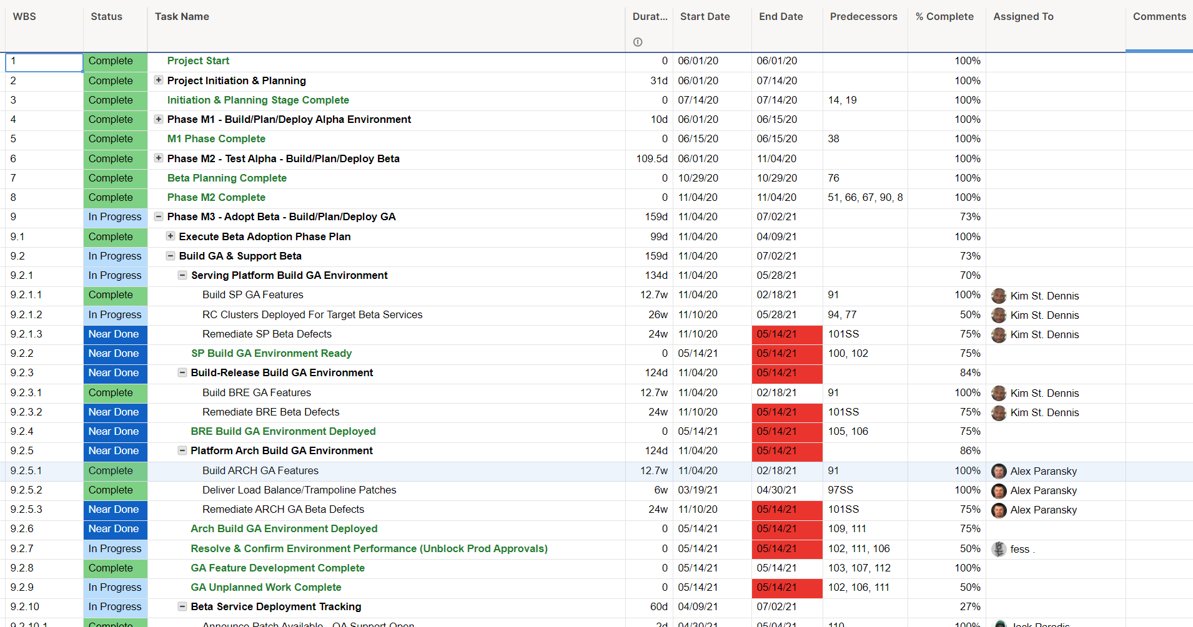
Sequence Constraint
Summary Task
Work Package
Resource Assignment
Activity
Duration Estimates

Slide 35
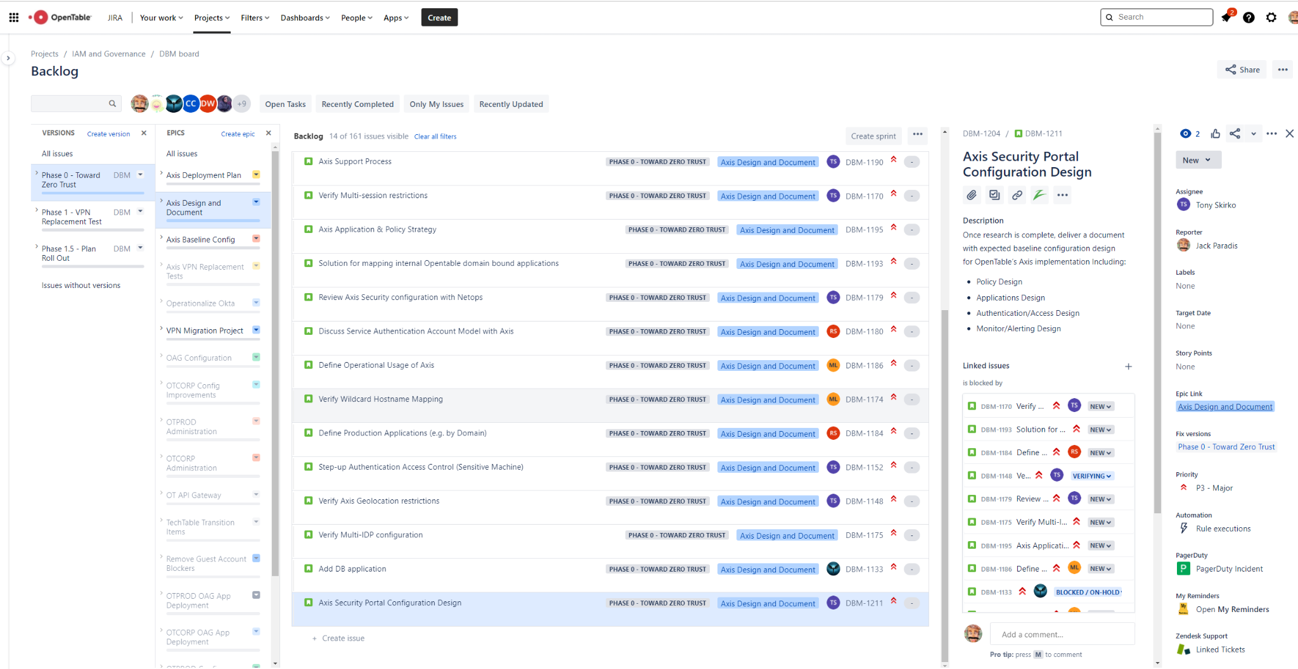
Summary Task
Resource Assignment
Activity
Duration Estimates
Sequence Constraint
Work Package

Slide 36
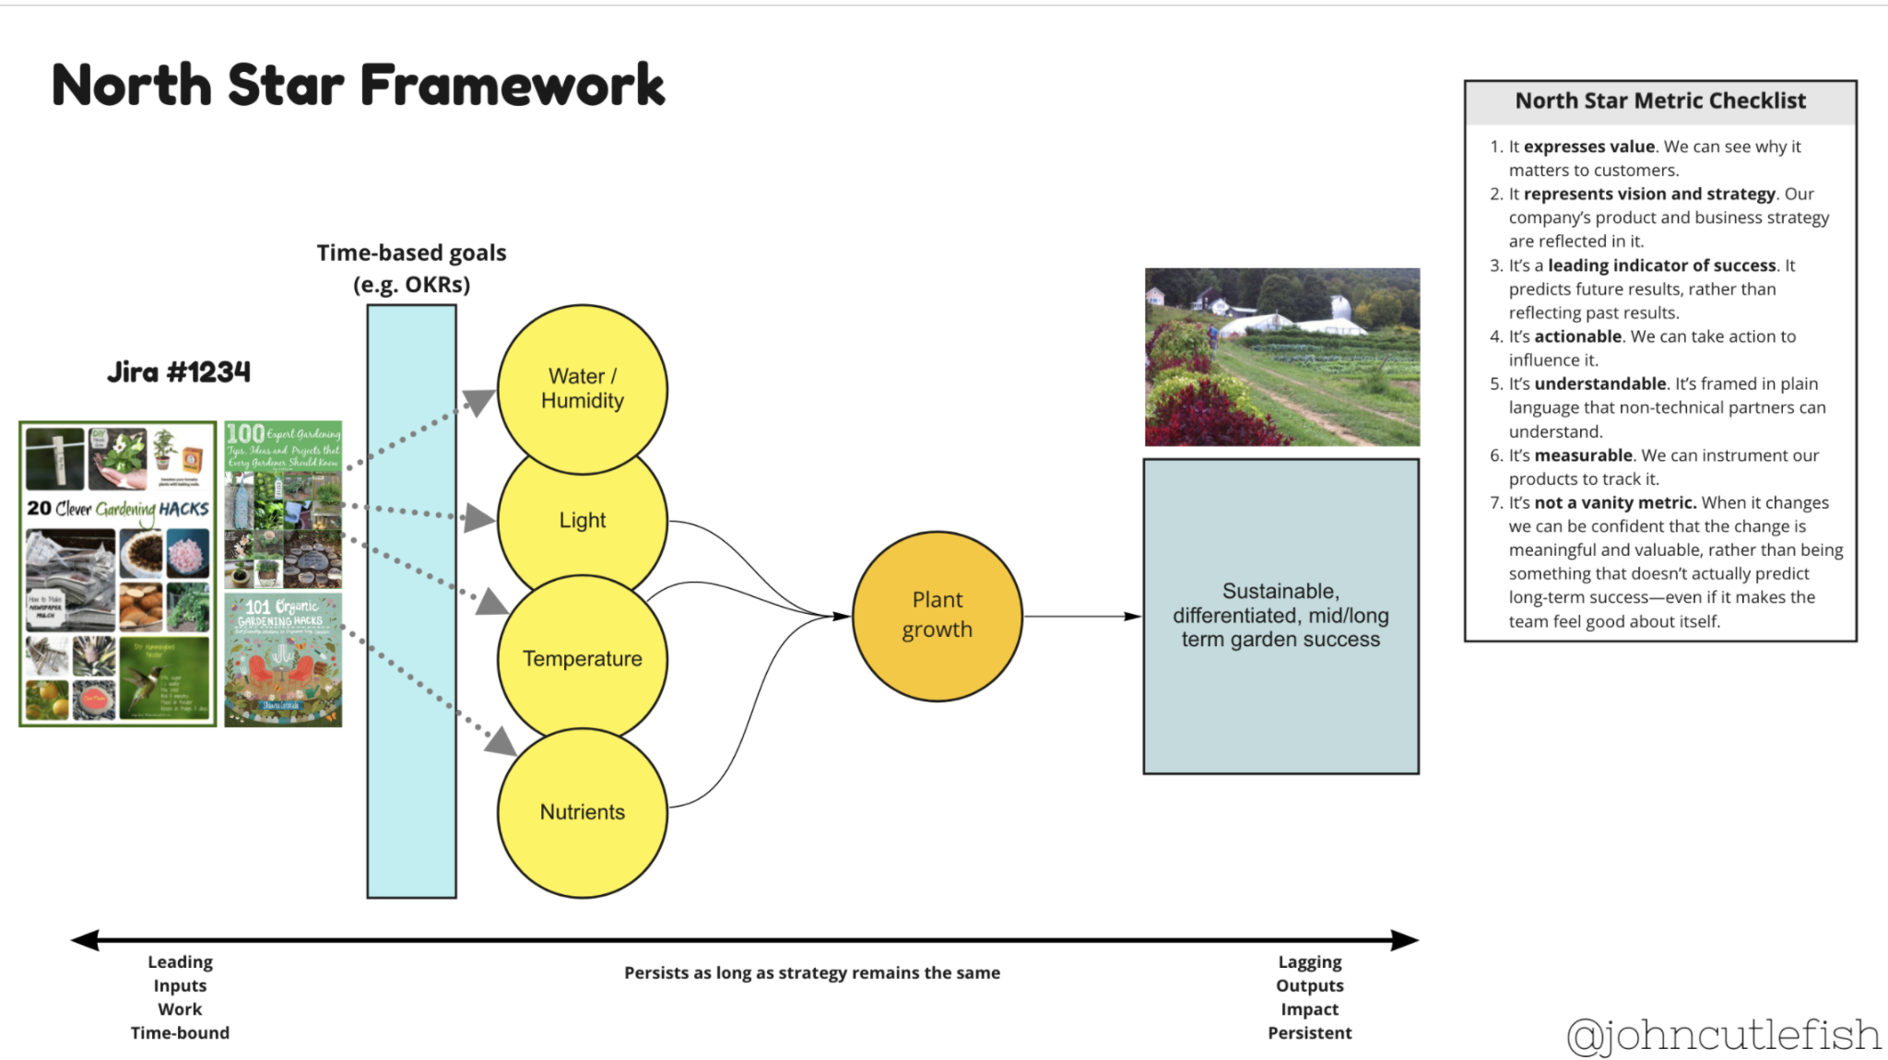
Beware Cascades and Rigidity? Maybe?
Good arguments against too much decomposition in WBS
Can impact creativity, ability to pivot and context of actions
But that might be OK for expected outcomes vs empirically driven processes
https://cutlefish.substack.com/p/tbm-2452-beware-of-the-cascade

Slide 37
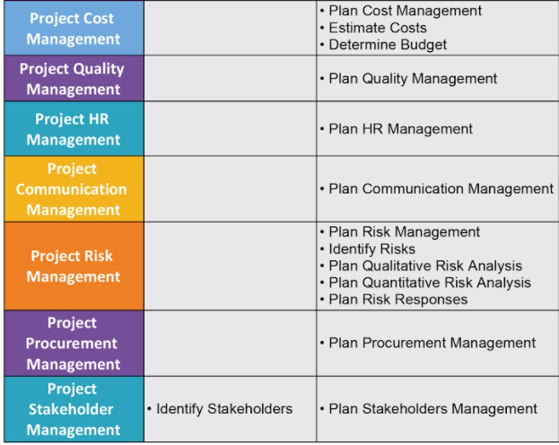
Consider Other Planning Processes

Slide 38
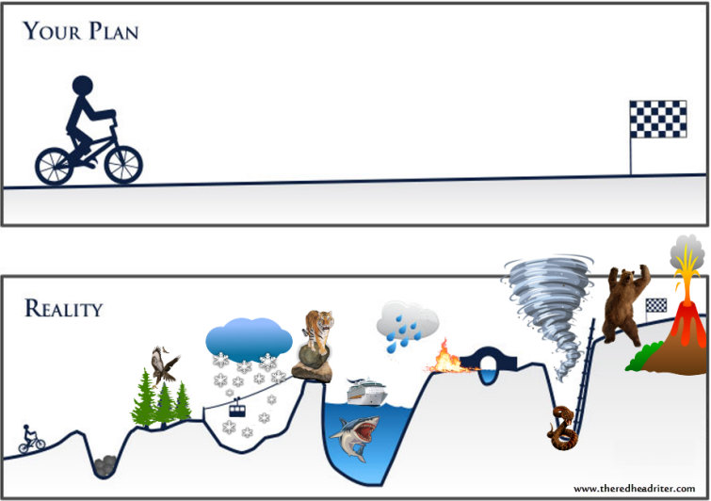
Execute -
Monitor & Control

Slide 39
Integration - Execute|Monitor & Control
PM Execution is largely about listening, focusing & amplifying
The project management plan is your guide through the process
All the knowledge areas are important to integrate - status documents & issues lists amplify key focus areas

Slide 40
Execution
Specs/Automation
Special Testing Activities
Retros/Feedbacks
Onboard Contractors
Forming, Storming, Norming, Performing
Stand ups, kick offs, off sites
Conflicts
Execute Comm Plan
Revise Plan
Hold Meetings
Legal
Finance
Budgets
Invoices

Slide 41
Monitor & Control
Scope Monitoring - Escalations
Budget Tracking & Forecasting
Definition of Done is being followed
Acceptance Criteria is being met
Retros are held to improve process
Refinement of backlog
Status reporting
Burn down analysis
Issue tracking (DAIR)
Team health, communications
Stakeholder development
Measurements
PROGRESSIVE ELABORATION/RETRO

Slide 42
Questions?

Slide 43
Appendix
Additional References
Example Charter
Example Project Management Plan
SDLC template
Scrum.Org info
WBS PBS info
Stakeholder Management
https://www.pmi.org/learning/library/effective-communication-better-project-management-6480

